Slide 1
REDUCE LAP-HF II:
Responder Group outcomes
Clinical evidence through 3 years for atrial shunt therapy in patients with EF≥40%

Slide 2







REDUCE LAP-HF II
STUDY POPULATION
STUDY SUMMARY
First randomized pivotal trial for atrial shunting in HF
Defined the baseline characteristics of the optimal patient population for atrial shunt therapy in patients with EF ≥40% (Responder Group)
Demonstrated the Corvia Atrial Shunt was safe & effective in the responder cohort at one year and continued through 3-years (longest published follow-up)
Randomized, double-blind, placebo-controlled
621 patients
vs
Atrial Shunt
Sham Control
PATIENTS INCLUDED: ≥40 years with symptomatic HF and EF ≥40% with elevated PCWP (≥25 mm Hg) and left-to-right gradient (≥5 mm Hg)
RESPONDER COHORT Identified (n=313)
Patients without significant pulmonary vascular disease (PVR<1.74 WU) and no pacemaker
Overall Population
Follow-Up Blinding Maintained Through 2 Years
Borlaug, BA et al. Circulation. 2022;145(21):1592-1604.

Slide 3
3-Year Responder group highlights
Demonstrate long-term benefit of atrial shunt therapy in Heart failure patients with EF≥40%
50% | 90% | NNT=13
Fewer patients hospitalized compared to sham control¹ | Greater chance of a >20 point improvement in KCCQ compared to sham control² | NNT to prevent a HF event in one patient is 55% lower than a popular SGLT2i^{3*}
Strong safety profile.
No statistical difference in CV mortality, stroke, or other serious adverse events vs sham.
¹Litwin, Sheldon E., et al. American Heart Journal 278 (2024): 106-116.; ²Baim Clinical Research Institute, data on file; ³Anker, NEJM, 2021
*Not a head-t0-head comparison; based on data from separate studies with different patient populations and other variables. Data presented for information purposes.

Slide 4
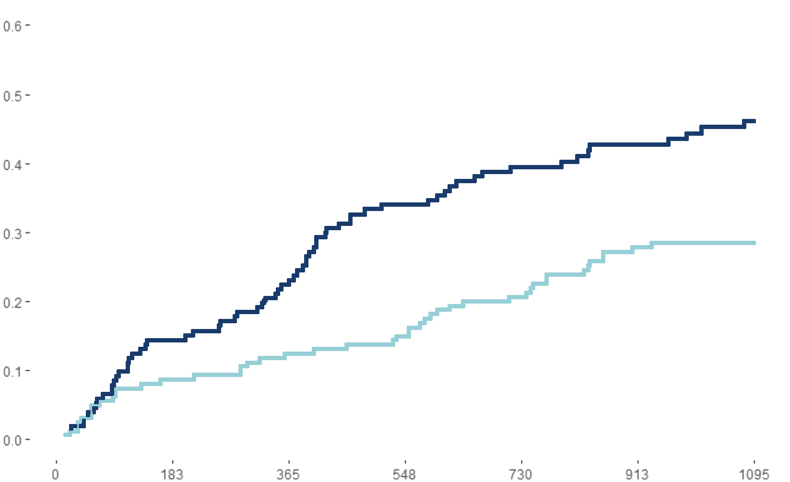
HF events Through 3years in responder groUp
Sustained reduction in hf event rate Despite 80% higher SGLT2i use in control arm
Mean cumulative heart failure events
HF hospitalizations or visits for worsening HF
0.6
0.5
0.4
0.3
0.2
0.1
0.0
Sham control
p=0.015
p=0.012
MCF
50% fewer
Corvia Atrial Shunt
0 | 183 | 365 | 548 | 730 | 913 | 1095
Time (days)
N=161
N=152
Treatment | 161 | 160 | 160 | 159 | 155 | 150 | 133
Control | 152 | 150 | 150 | 146 | 139 | 118 | 101
Litwin, Sheldon E., et al. American Heart Journal 278 (2024): 106-116.
Notes:
Corvia Sham 2 Years 8.13% 16.89% 3 Years 11% 21%

Slide 5
HF event risk reduction at 3 years in perspective
Corvia atrial shunt responder group results in context of sglt2i RESULTS IN HFpEF
NNT to prevent a HF event for the Corvia Atrial Shunt is ~55-60% lower than that for popular SGLT2 inhibitors
REDUCE LAP-HF II ¹
EMPEROR
Preserved^{^2}
DELIVER³
% Reduction in HF Events
REDUCE LAP-HF II
EMPEROR
Preserved
DELIVER
*Not a head-t0-head comparison; based on data from separate studies with different patient populations and other variables. Data presented for information purposes. ^EMPEROR Preserved limited HF events to hospitalizations for heart failure per patient. 1Litwin, Sheldon E., et al. American Heart Journal 278 (2024): 106-116.; ²Anker, NEJM, 2021; ³Solomon et al, N Engl J Med, 2022.
Notes:
REDUCE LAP-HF II (HF events requiring IV diuretics or intensification of oral diuretics)
365
Corvia 8.12%
Sham 13.85%
ARR 5.73%
RRR 41.4%
NNT 17
730
Corvia 12.61%
Sham 19.30%
ARR 6.69%
RRR 34.7%
NNT 15
1095
Corvia 15.80%
Sham 23.51%
ARR 7.71%
RRR 32.8%
NNT 13
EMPEROR Preserved: 3Y, hospitalizations for heart failure per patient (first and recurrent)
Therapy 0.29%
Control 1.78%
ARR 3.42
RRR 16%
NNT 29
DELIVER: 3Y, cumulative incidence of worsening HF events (first and recurrent)
Therapy 0.21%
Control 1.58%
ARR 3.09
RRR 13%
NNT 32

Slide 6
Quality of Life Through 3years in responder group
CORVIA PATIENTS experienced large, consistent improvement across all kccq domains
>10 points better
p < 0.001
p = <0.001
90% more likely for Corvia patients
NNT = 5 | Treating just 5 patients with a Corvia Atrial Shunt yields an additional patient with a large (>20-point) 3-year KCCQ improvement.
Baim Clinical Research Institute, data on file.; Litwin, Sheldon E., et al. American Heart Journal 278 (2024): 106-116.
Notes:
Since 44% of Corvia patients saw a KCCQ improvement of >20, for every (1/.44) 2.3 patients treated, one will see >20 point improvement. On the other hand since sham is 23%, one in 4.3 control patients will improve >20 points. The NNT figure focuses on the additional benefit above control.

Slide 7
NYHA Functional class in responder group
Corvia patients more often benefit from nyha class improvement at 3 years
p=0.003
Corvia patients were ~70% more likely to improve ≥1 NYHA Class through 3 years
>70% more likely for Corvia patients
N= 161
N=152
Baim Clinical Research Institute, data on file.

Slide 8
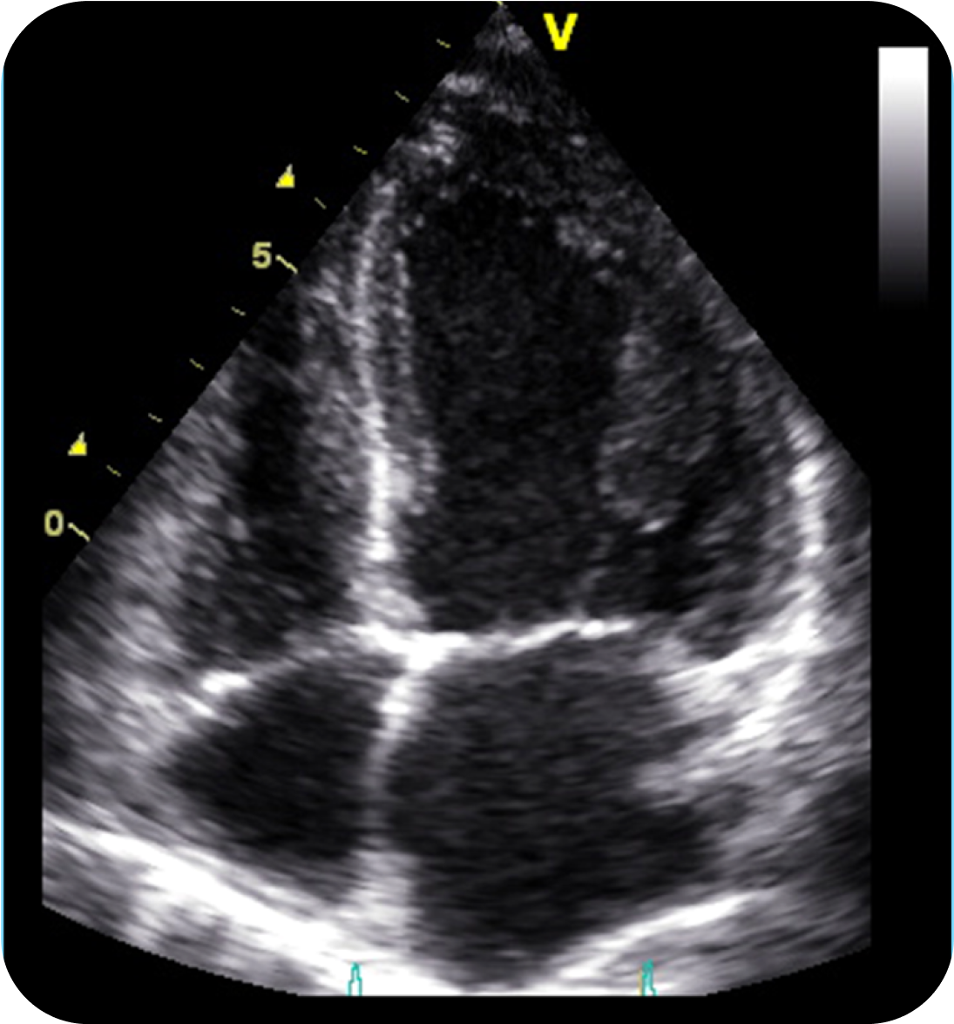
Echo evidence of left heart unloading
supports favorable long-term effects of atrial shunting
CONCLUSION | ECHOGRAPHIC EVIDENCE
Shunt is unloading left heart
Shunt is not negatively affecting right heart
Blood flow through shunt from LA to RA
98% patent
@ 2 years
A
Decreased LA/LV volume vs sham
Decreased LA pressure vs sham
Decreased mitral regurgitation grade vs sham
B
No difference in PASP vs sham
A
No difference in RA systolic pressure vs sham
B
No difference in RV systolic function vs sham
C
C
Increased RA volume vs sham
Increased RV end-diastolic volume vs sham
2Y analysis showed that the Corvia Atrial Shunt led to reverse remodeling of the left heart chambers and increases in volume of the right heart chambers, without compromising right ventricle systolic function compared to sham.
Patel, RB., et al. JAMA Cardiol. 2024 Jun 1;9(6):507-522

Slide 9
Strong safety profile in responder group at 3years
no statistically significant safety risk versus SHAM
Events through 3 years | Corvia Atrial Shunt N=161 | Sham control N=152 | p-value*
All-Cause Mortality | 8.8% | 5.2% | 0.26^
Cardiovascular Mortality | 4.4% | 2.2% | 0.35
Non-fatal Ischemic Stroke | 1.9% | 0.0% | 0.25^†
Thrombo-embolic Complications | 0.0% | 1.5% | 0.21^
New Onset or Worsening of Kidney Dysfunction | 10.7% | 19.3% | 0.04
MACE (Any MACE) | 6.9% | 3.7% | 0.30
Cardiac Death | 3.8% | 2.2% | 0.51
Myocardial Infarction | 2.5% | 2.2% | 1.00
Cardiac Tamponade | 1.3% | 0.0% | 0.50
Emergency Cardiac Surgery | 0.0% | 0.0% | --
Newly Acquired Persistent or Permanent AFib or Atrial Flutter | 5.7% | 6.7% | 0.72
* Incidence rate comparison using logistic regression at a two-sided 0.05 level of significance except as noted
^ Fishers exact test.
† No new events (N-F iCVA) between year 2 and year 3.
Litwin, Sheldon E., et al. American Heart Journal 278 (2024): 106-116.; Baim Clinical Research Institute, data on file.

Slide 10
Executive summary
Largest Device Therapy Trial in HFpEF
Addresses a critical unmet need in cardiology.
Significant Advance in Patient Selection
First to identify the baseline characteristics of large Responder Group (50% of the population) with normal exercise pulmonary vascular resistance (peak PVR <1.74) & no CRM devices
Responder Group Clinical Benefits Continue Through 3 Years
  50% reduction in HF hospitalizations (11% vs. 22%, p = 0.015) & NNT less than ½ of SGLT2i meds*
  90% more likely to achieve 20+ point KCCQ-OSS improvement vs sham control with a low NNT=5
  No statistically significant safety risk; favorable long-term echo results without RV dysfunction
Supported by Pathophysiologic Consistency
Clinical outcomes align with expected pathophysiology.
RESPONDER-HF Confirmatory Study Ongoing
Global, sham-controlled, randomized trial to validate responder group findings
*Not a head-t0-head comparison; based on data from separate studies with different patient populations and other variables. Data presented for information purposes

Slide 11




Responder-hf study design
Randomized, multi-center, double-blind, sham-controlled confirmatory trial
PURPOSE: Confirm the clinical efficacy of the Corvia Atrial Shunt in HF patients with LVEF ≥40%, elevated left sided filling pressures, and who remain symptomatic despite optimal Guideline Directed Medical Therapy (GDMT).
Study Population
N = 260 randomized
Age ≥40, preserved RV function, exercise PCWP (≥25mm Hg) with left-to-right gradient (≥ 5mm Hg), exercise PVR <1.75 WU, no cardiac rhythm management device
*Modifications from REDUCE LAP-HF II
Atrial Shunt Treatment
N = 130
PRIMARY COMPOSITE ENDPOINT
Rate of total HF events (first and recurrent) up to 24 months, analyzed when last randomized patient reaches 12 months
KCCQ change from baseline to 12 months
Finkelstein-Schoenfeld hierarchical analysis using Bayesian statistics
Sham Control
NN = 130
MAJOR SECONDARY ENDPOINT
Rate of cardiovascular death through 12 months
Cross-over to treatment allowed after 24M follow-up visit

Slide 12
MKT1022 Rev 00 2025-01
Corvia Shunt System® is a registered trademark of Corvia Medical, Inc. ©2025 Corvia Medical, Inc.

Slide 13
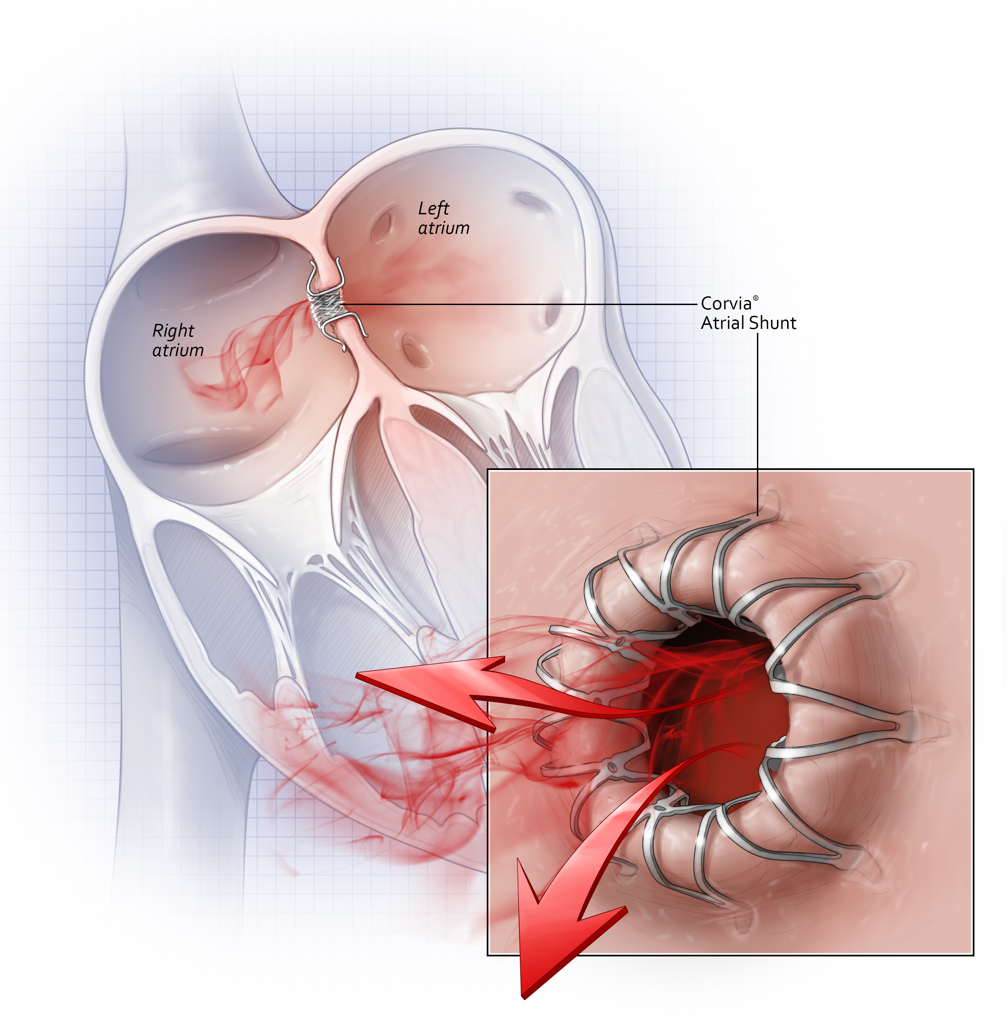
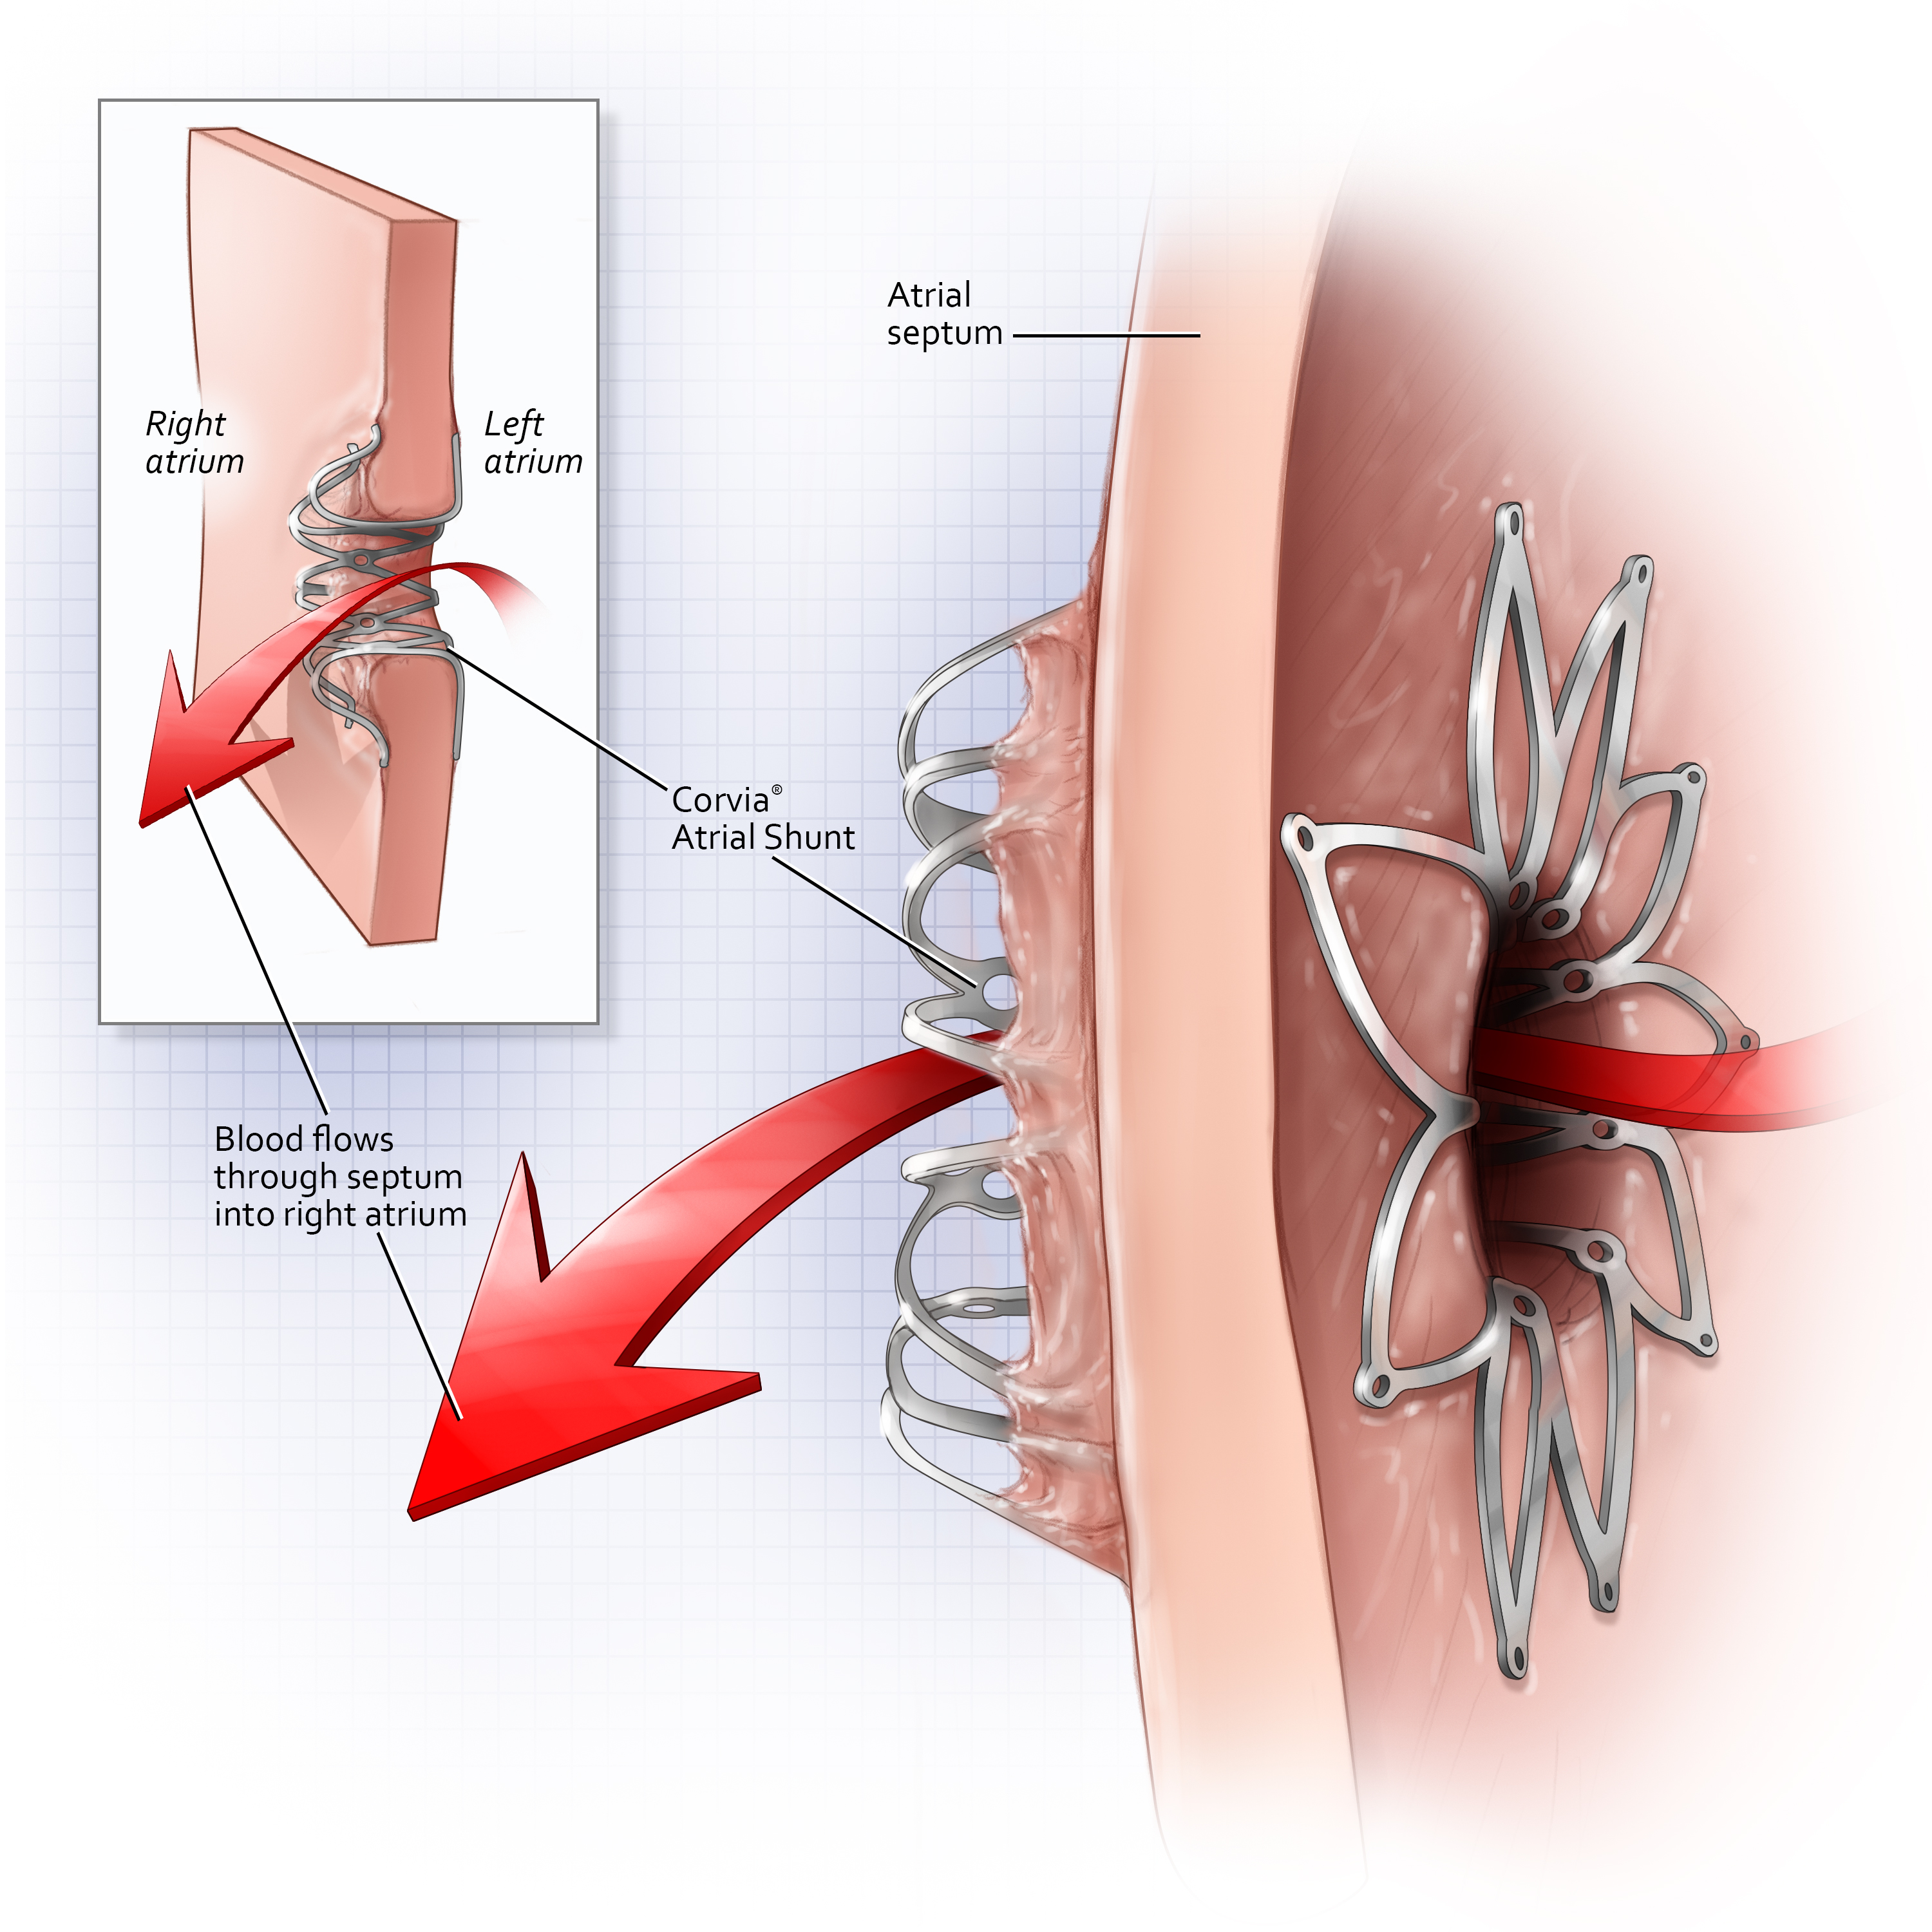
Corvia® Atrial Shunt
Dynamic Left atrial decompression
8 mm
PROPOSED MODE OF ACTION:
dynamic decompression of overloaded LA chamber by shunting blood from LA → RA (Qp:Qs 1.2-1.3)
Feldman T…Shah SJ. Circ Heart Fail 2016.

Slide 14
Reduce lap-hf II study design
Randomized phase III, multi-center, double-blind, Sham-controlled trial
PURPOSE: Evaluate the clinical efficacy and safety of the Corvia Atrial Shunt to improve quality of life and reduce HF related symptoms and events in patients with HFpEF or HFmrEF
Study Population
N = 626 randomized
Symptomatic HF, ongoing GDMT, age ≥40, LVEF ≥40%, preserved RV function, elevated exercise PCWP (≥25 mm Hg) with left-to-right gradient (≥ 5mmHg)
Atrial Shunt Treatment
N=314
PRIMARY ENDPOINT
Hierarchical composite of cardiovascular mortality or non-fatal, ischemic stroke through 12m, rate of total HF events (first and recurrent) through 24m & time to first HF event, change in KCCQ score between baseline & 12m
Sham Control
NN=312
SECONDARY ENDPOINTS
Composite safety endpoint (MACCRE)
Rate of HF admissions or IV diuresis, through 24m
Change in NYHA Class between baseline & 12m
Change in KCCQ score between baseline & 12m
Berry, N et al. Am Heart J, vol. 226 (2020): 222-231

Slide 15
HF event Details through 3 years in responder group
Significant reduction in most impactful and costly HF events despite lower HF Medication use
 | Corvia Atrial Shunt (N = 161) |  | Sham Control (N = 152)
 | # Events | % (#) Patients | # Events | % (#) Patients | P-value
Heart Failure Events | 45 | 15.72% (25/159) | 68 | 25.19% (34/135) | 0.057
Outpatient Visit¹ | 13 | 6.29% (10/159) | 16 | 9.63% (13/135) | 0.384
Hospitalization | 32 | 10.69% (17/159) | 52 | 21.48% (29/135) | 0.015
Treatment
Oral Diuretics Only | 7 | 3.77% (6/159) | 7 | 2.96% (4/135) | 0.758
IV Diuretics | 38 | 11.95% (19/159) | 60 | 22.22% (30/135) | 0.027
Medications | Baseline | 36 Month | Baseline | 36 Month
Sacubitril/Valsartan | 0.0% (0/161) | 2.7% (4/146) | 0.0% (0/152) | 2.7% (3/112)
SGLT2 inhibitors | 2.5% (4/161) | 17.8% (26/146) | 4.6% (7/152) | 32.1% (36/112)
Novel HF medication use in control group 80% higher than shunt group
¹Outpatient urgent visit location includes: ER, acute care facility, outpatient clinic, MD office.
Baim Clinical Research Institute, data on file.

Slide 16
QOL Through 3years in responder group
Sustained long-term improvements in KCCQ-OSS and low nnt to achieve large kccq improvement
p=0.03
p=0.06
p=<0.001
5.5 points
4.6 points
10.3 points
N= 153
N=141
N=137
N= 143
N=122
N= 90
NOTE: 5-point change in KCCQ OSS is considered clinically meaningful
Baim Clinical Research Institute, data on file.

Slide 17
QOL improvement in perspective
KCCQ improvement over placebo comparable TO the MOST INNOVATIVE THERAPIES in HFpEF
At 3Y, the KCCQ improvement enjoyed by Corvia patients is multiple times greater than some of the most popular pharmaceutical and device therapies for HFpEF.
*Not a head-to-head comparison; based on data from separate studies with different patient populations and other variables. Data presented for information purposes. ¹Baim Clinical Research Institute, data on file. ²Butler, J., et al. (2022). Circulation, 145(3), 184–193. ³Kosiborod, M. N., et al. (2023). JACC, 81(5), 460–473. ⁴Stone, G. W., et al. (2018). NEJM, 379(24), 2307–2318. ⁵Shuvy, M., et al. (2023). ESC Heart Failure, 10(2), 1122–1132. ⁶Veazie, P. J.,et al. (2012). JACC, 60(19), 1940–1944.
Notes:
Comps’ improvement in KCCQ
CORVIA (REDUCE LAP-HF II) KCCQ-OSS 1Y baseline=~45 Improvement over placebo=5.5
CORVIA (REDUCE LAP-HF II) KCCQ-OSS 2Y baseline=~45 Improvement over placebo=4.6
CORVIA (REDUCE LAP-HF II) KCCQ-OSS 3Y baseline=~45 Improvement over placebo=10.3
Empagliflozin KCCQ-OSS 1y baseline=68.9 improvement over placebo=1.6 points
Dapagliflozin KCCQ-OSS 8m baseline=~66 improvement over placebo=2.1 points
Entresto KCCQ-CSS 8m baseline=? improvement over placebo=1 point
CCM KCCQ-OSS 24w baseline=49 improvement over placebo=18 points
CardioMEMS KCCQ-OSS 12m baseline=? Improvement over placebo=1.1 points
Mitraclip (COAPT trial) KCCQ-OSS 12m baseline=54 Improvement over placebo=16 points
Mitraclip (COAPT trial) KCCQ-OSS 24m baseline=54 Improvement over placebo=19.9 points
Triclip KCCQ 12m baseline=55 Improvement over placebo=11.7 points
CRT (MADIT) 12m Baseline=75 Improvement over placebo=2 points
CRT (MADIT) 24m Baseline=75 Improvement over placebo=4 points
CRT (MADIT) 36m Baseline=75 Improvement over placebo=2 points

Slide 18
HF Incidence Rate reduction in responder group
Sustained risk reduction over time
Absolute Risk Reduction
Relative Risk Reduction
Number Needed to Treat
% Reduction in HF Events
Baim Clinical Research Institute, data on file.
Notes:
The numbers in the right column below are recalculations using data from the Baim reports:
ARR at 365 days: 13.85-8.12 = 5.7%
RRR: (13.85-8.12)/13.85 = 41.4%; HR = 0.586
NNT:1/ARR = 17.5 = ~18
ARR at 730 days: 19.25-12.55 = 6.7%
RRR: (19.3-12.6)/19.3 = 34.7%; HR = 0.653
NNT:1/ARR = 14.9 = ~15
ARR at 1095 days: 23.5-15.8 = 7.7%
RRR: (23.5-15.8)/23.5 = 32.8%; HR = 0.73
NNT: 1/ARR = 13

